Slide 1
Labor Unions
By Oliver, Thea, Erick, and Lisa

Slide 2
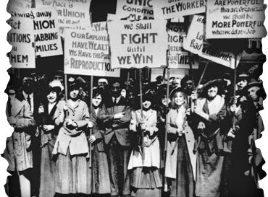
What is a Labor Union?
An organization that brings together workers in the same trade, job, to fight for better wages and working conditions. :)

Slide 3
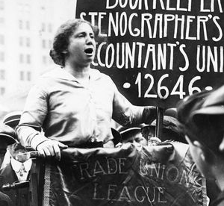
Rose Schneiderman
Rose Schneiderman was an American trade unionist who fought for women’s and worker’s rights in the early 20th century. She believed the power of the union was stronger than that of the individual, and helped give disadvantaged women a voice to speak up for themselves.

Slide 4
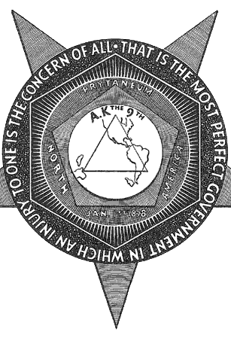
The Knights of Labor

Slide 5
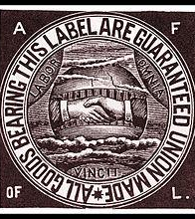
The American Federation of Labor
The American Federation of Labor was an organization formed by the leaders of several local unions in Ohio . They took on a more peaceful approach than labor unions, negotiating instead of striking,and if any of their members decided to join unions, they had their names written down and they were permanently expelled from the federation.

Slide 6
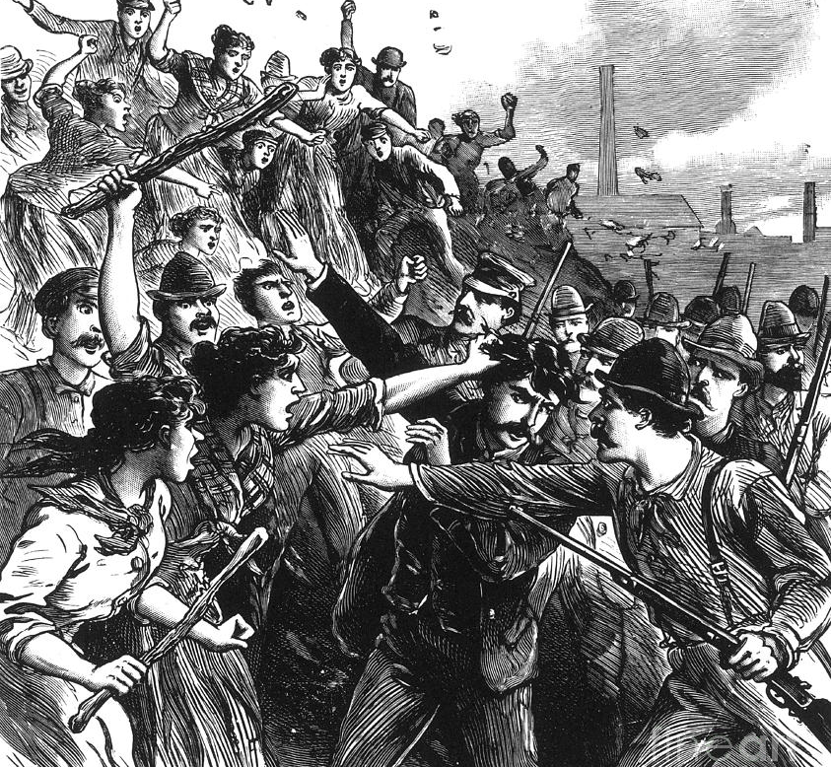
The Homestead Strike
The Homestead Strike is one of the well known labor union strikes. Henry Clay Frick, the owner of the factory, prevented the strike by hiring armed guards to stop the riot. In the end, Henry Clay Frick silenced the protesters

Slide 7
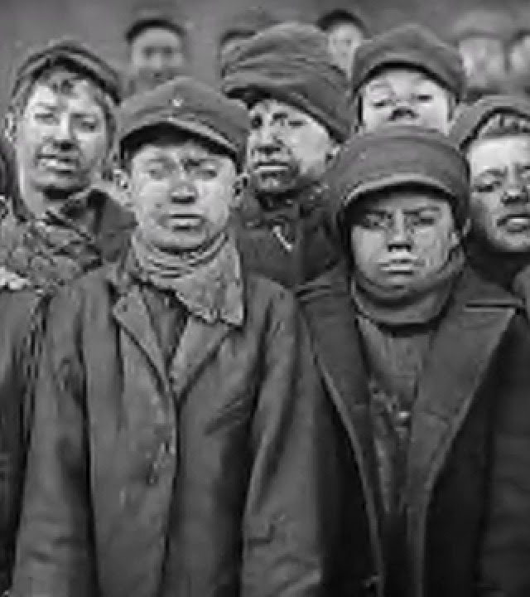
Tactics of Labor Unions
Labor Unions used many tactics to gain what they want. They rioted and went on strike to receive the better conditions they deserved. They fought for improving work conditions, raising their pay, and having shorter work hours.

